Slide 1
2022 Alberta, British Columbia and Yukon Virtual Advising Symposium

Slide 2







Terina Mailer (she/her)
Manager, Academic & Career Advising
UBC’s Okanagan Campus
terina.mailer@ubc.ca
250-807-8726
www.linkedin.com/in/terinamailer
https://www.facebook.com/terina.mailer/
terina_l_mai
@Terina_UBCO

Slide 3
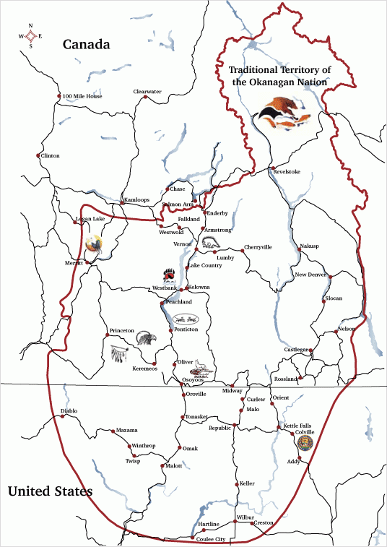
“The Okanagan Nation Alliance (ONA) was formed in 1981 as the inaugural First Nations government in the Okanagan which represents the 8 member communities including; Okanagan Indian Band, Upper Nicola Band, Westbank First Nation, Penticton Indian Band, Osoyoos Indian Band and Lower and Upper Similkameen Indian Bands and the Colville Confederated Tribes on areas of common concern. Each community is represented through the Chiefs Executive Council (CEC) by their Chief or Chairman.
The Syilx/Okanagan people still affirm that the land is theirs, as no treaty has been negotiated”
syilx.org

Slide 4
Please take care of yourself.

Slide 5
The goal of creating a community of care on our campuses addresses the intersectionality of mental health (both student and advisor), the pandemic, indigenization and EDI, best practices, and cross-department communication. This session will address that intersectionality as a foundation for and the values underpinning post secondary institutions as communities of care. You will leave the session with tools and steps for how to foster this on your own campuses.

Slide 6



Slide 7
Where were we prior to the pandemic?
    https://rdcu.be/cH7oe
    Linden, B., Boyes, R. & Stuart, H. Cross-sectional trend analysis of the NCHA II survey data on Canadian post-secondary student mental health and wellbeing from 2013 to 2019. BMC Public Health 21, 590 (2021). https://doi.org/10.1186/s12889-021-10622-1
    analysis indicated that the proportion of students self-reporting mental health related challenges, including stress, psychological distress, and diagnosed mental illnesses increased between the 2013, 2016 and 2019 iterations of the NCHA II conducted among Canadian post-secondary students.
    (NCHA – National College Health Assessment)

Slide 8
Factors that negatively impact mental health:
childhood abuse, trauma, or neglect
social isolation or loneliness
experiencing discrimination and stigma, including racism
social disadvantage, poverty or debt
bereavement (losing someone close to you)
severe or long-term stress
having a long-term physical health condition
unemployment or losing your job
homelessness or poor housing
being a long-term care-giver for someone
drug and alcohol misuse
domestic violence, bullying or other abuse as an adult
significant trauma as an adult, such as military combat, being involved in a serious incident in which you feared for your life, or being the victim of a violent crime
physical causes – for example, a head injury or a neurological condition such as epilepsy impacts our behaviour and mood
https://www.mind.org.uk/information-support/types-of-mental-health-problems/mental-health-problems-introduction/causes/

Slide 9
HOW CAN WE
HELP
EACH OTHER?

Slide 10


Slide 11


Slide 12
What are we doing to create a network of care on our campuses?
UBC Wellbeing
    a collaborative effort to make the University a better place to live, work and learn through a systems-wide approach to wellbeing across our campuses
    Guided by the Okanagan Charter and UBC’s Wellbeing Framework
Okanagan Charter
    An International Charter for Health Promoting University and Colleges, which calls upon post-secondary schools to embed health into all aspects of campus culture and to lead health promotion action and collaboration locally and globally
UBC’s Wellbeing Framework
    our commitment and approach to embedding wellbeing across our university culture and leading action and collaboration locally and globally

Slide 13
How are we embedding wellbeing across our university culture?
Wellbeing is threaded throughout strategic plans, in research projects across diverse disciplines, and embedded through a broad range of programs, services and initiatives
Examples and research
Thrive
    when we come together as a UBC community to learn about, talk about, and explore ways to support our mental health.
Move UBC
    university-wide annual initiative to increase physical activity and reduce the time students, faculty, staff, and the UBC community spend being inactive
Healthy Beverage Initiative
    a collaboration between faculty, staff, student, and vendor stakeholders, to create a campus environment where it's easier to make healthier choices

Slide 14
How are we embedding wellbeing across our university culture?
QPR Suicide Prevention Training
    training for students, faculty, and staff to help them recognize suicide warning signs, approach someone who may be at risk, persuade the person to seek appropriate health services, and connect the person to resources that will help resolve crises.
Food Security Initiative
    a collaborative, multi-disciplinary, and systems-based approach to addressing food insecurity at UBC
Smoke and vape-free areas
    designated areas around our campuses is one way to create a happier, healthier campus community

Slide 15
How are we embedding wellbeing across our university culture?
Wellbeing Champions Programs
    Our vision of becoming a health and wellbeing-promoting campus that we approach collectively and collaboratively, supported by passionate Wellbeing Champions—students, faculty, and staff who are committed to helping UBC achieve this vision by helping to embed and promote wellbeing in their workplaces, learning environments, and portfolios.
    Empower staff and faculty to support wellbeing activities within UBC departments
    Provide opportunities to build knowledge and apply learnings in the workplace.
    Support staff and faculty in their efforts to positively impact workplace wellbeing

Slide 16
How are we embedding wellbeing across our university culture?
Wellbeing in teaching and learning environments
    faculty and staff collaborating to transform learning environments to support student wellbeing, engagement, and academic tenacity
    examples: taking learning into nature, embedding mental health literacy, encouraging self-compassion
BARK
    Building Academic Retention Through K9s
    explores how therapy dogs reduce stress and increase well-being in a variety of populations — from elementary and university students to law enforcement personnel
Early Alert
    support student learning and success by helping faculty and staff provide more comprehensive support for students facing difficulties that put their academic success at risk.

Slide 17
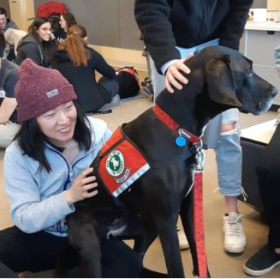
How do I contribute?
Take personal responsibility
    the space I occupy
    my personal interactions
    Listen
    Early Alert
    Mental Health First Aid
Volunteer
    BARK
Participate & Contribute
    Thrive
    QPR Trainer
    AOAC & EDI training

Slide 18
HOW CAN YOU
CONTRIBUTE TO A CARING
COMMUNITY ON YOUR
CAMPUS?
(BREAKOUT ROOMS)

Slide 19
Share your ideas at www.menti.com
The voting code 8336 9814

Slide 20
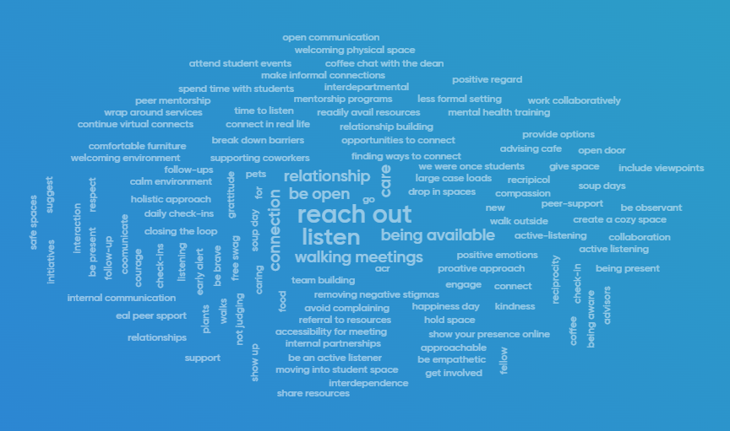

Slide 21
Q&A Discussion

Slide 22
Terina Mailer (she/her)
Manager, Academic & Career Advising
UBC’s Okanagan Campus
terina.mailer@ubc.ca
250-807-8726
www.linkedin.com/in/terinamailer
https://www.facebook.com/terina.mailer/
terina_l_mai
@Terina_UBCO

